Slide 1
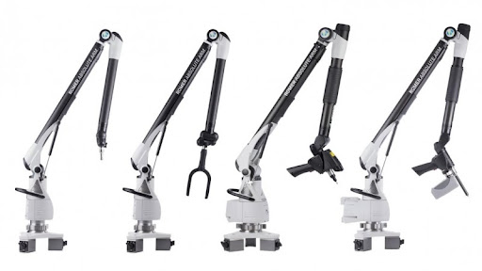
Term 3 Week 6 – Progress Meeting
OVERVIEW:
Report updating
Software development

Slide 2
General Update
Introduction updated – Joint focused
Literature review in the process of being updated
Safety report still being written
Software development has begun
Testing a few electrical components
Deriving control signal for electromagnet
Documenting experiment report

Slide 3
Q&A
Can extra documentation be included in the appendix?
Drawing pack
Safety report
Experimental report
Or this is what the portfolio is for?

